Slide 1
SDMAY25-10
USER NEEDS &
REQUIREMENTS
TESSA LANZEL, PAIGE SCHNEIDER, MOLLY ROONEY, MAY EDEL, ELICIA BARANOWSKI, ALEXANDRA RAUER, JOSHUA CHIANG FUNG

Slide 2
OVERVIEW
Develop a mobile application for both Google Play Store and Apple App store using their native language
Apps will connect to existing firmware and database to display and store user’s force output for each lift and metrics over a period of time

Slide 3
PROBLEM
Unknown knowledge for what weights will improve strength without injuring
Current data is not transferable across devices
No security
Current Application is full of bugs
Availability to users

Slide 4
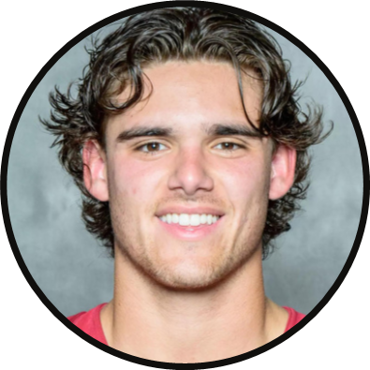
IN-SEASON ATHLETE
USER NEEDS
An in-season athlete needs an easy and accurate way to measure their maximum strength for the day because they want to perform and train at their best
An in-season athlete needs a safe and accurate way to measure their maximum strength for their lifts because they want to have an injury-free workout before their upcoming competition
An in-season athlete needs a quick and precise way to measure their strength for the day because they want to ensure they are getting stronger

Slide 5
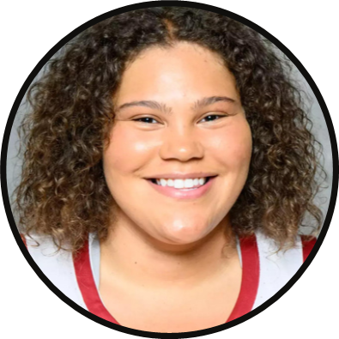
OFF-SEASON ATHLETE
USER NEEDS
An off-season athlete needs an easy and accurate way to measure their metrics to gain strength and reach their off-season goals in a healthy way to reduce injuries
An off-season needs a simple way to track their fitness during the off-season because they want their strength goals to be hit before their season starts up again

Slide 6
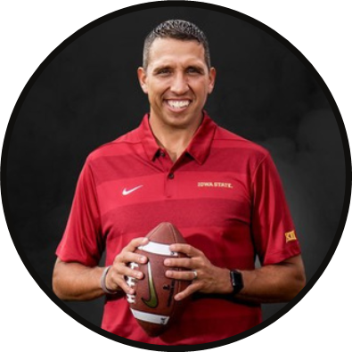
COACH
USER NEEDS
Coach Campbell needs a way to monitor and track the strength and progress of all of his athletes because it will allow him to help each player perform their best
Coach Campbell needs an easy way to track the individual strength and progress of each of his athletes because it will allow him to train them based on their individual needs and goals

Slide 7
REQUIREMENTS
Basic functionality of our project: Most important requirement to accomplish
FUNCTIONAL
The product should measure the maximum strength of a lift and store that information to a user’s profile
The product should be able to display data about the lifts
The user should be able to use the application on their personal device (iOS and android apps)
The product should be able to create new users
The product should be able add users to different teams
The user should be able to create new exercises
The hardware should disconnect with the software when the application is closed
The app shall be able to connect via bluetooth to the hardware on the weight rack
The user should be able to see data about past lifts in a graphic display
Frequently recording and saving user data should be easy for the user
The product is supposed to help users track their progress in their training with recorded data

Slide 8
REQUIREMENTS
PHYSICAL
The rack should be able to fit in a weight room or any space where a coach might want to conduct their training
The application should be scalable on different screen sizes (tablets, phones)
The software should run on any smart application that uses Google Play Store or Apple app store
Needs to be viewable on different types of personal devices

Slide 9
REQUIREMENTS
RESOURCE
The hardware should be available to all devices to connect properly via bluetooth.
The app needs to reference the api and database to log and chart data.
The application should use an external API to graph force the user exerts on the rack.
This is an existing requirement that the client expects to be maintained

Slide 10
REQUIREMENTS
AESTHETIC
The app should be in compliance with design standards and should be easily used by all types of users
The app should follow a clear and consistent color scheme
The app should use colors that colorblind people can see
This is important as it requires us to think about how people see, whether they are color blind or poor eyesight

Slide 11
REQUIREMENTS
This was a big design flaw that we as a team saw and was very frustrating to work with
USER EXPERIENTIAL
The application should rotate depending on the device’s orientation.
The application shall not use red/green colors as these are hard for user’s with color blindness to see
The application should have different options for different types of users (coach can add users to a team)

Slide 12
REQUIREMENTS
ENVIRONMENTAL
The environment should be in a weight room as this is to help their training
The product should be able to work in a room with multiple devices with their bluetooth on
The hardware should stay connected to one device if others have their bluetooth on
The software shall be used with the physical weight rack near it.

Slide 13
Engineering Standards
ISO 639 - Language Code
ISO 14000 family -
Environmental management
ISO 31000 - Risk Management
ISO 9660 -
ISO images for computer files
Required for global sales, ensures proper language representation
Within Iowa State, environmental management would be important because it could constantly improve the device
Helps keep the application in compliance with risks
Make sure the images we use are enabled on compact discs
ISO 9241 -
Ergonomics of Human-system interaction
ISO 27001 -
Information security management
IEEE P3411 - Standard for
smart identification in Internet of things
Ensures that the software is user-friendly and accessible to all users
Ensures that the users personal data is secured
Needed for the transport of data via Bluetooth to connect the software to the hardware

Slide 14
CONCLUSIONS
Users Needs are a mix of accuracy and tracking of fitness and strength goals
User requirements:
Functional: The user should be able to access and easily find and read their statistics, and add and remove users
Physical: have the rack available and the app as well
Resource: App needs easy access to the api and database
Other: accessible to colorblind people, rotates to match devices orientation, app will be used near the rack in a weight room
Standards: language code, environmental management, Risk management Ergonomics of human interaction, Information security management, etc.

Slide 15
QUESTIONS?

